Slide 1
Accuracy evaluation of FVM based DNS to resolve highly turbulent free shear flows
Shashank S. Tiwari
25 September 2019

Slide 2
Domain Independence for Re =10000
Sr.no. | Domain Size | Mesh Count | Mesh size | Sim.C_{D}
D1 | 60d x 20d x 20d | 33.7M | 0.2d with 10 prism layers of size 0.1d | 0.411
D2 | 60d x 14d x 14d | 16.8M |  | 0.404
D3 | 60d x 10d x 10d | 8.55M |  | 0.375
D4 | 45d x 20d x 20d | 25.4M |  | 0.408
D5 | 45d x 14d x 14d | 12.5M |  | 0.394
D6 | 45d x 10d x 10d | 6.43M |  | 0.348
D7 | 30d x 20d x 20d | 17M |  | 0.396
D8 | 30d x 14d x 14d | 8.37M |  | 0.398
D9 | 30d x 10d x 10d | 4.27M |  | 0.395
D10 | 16d x 10d x 10d | 2.30M |  | 0.273
Exp.C_{D} = 0.40
(CFL C<1)

Slide 3
14d
5d
25d
y
d
x
14d
z
Velocity inlet
Symmetry
10d
8d
8d
y
x
10d
z

Slide 4
Mesh
0.3 x 0.14x0.14
8 Million
0.16x0.1x0.1
128 Million

Slide 5
Mesh Details
30d x 14d x 14d and Symmetry Boundary Conditions along the domain
Re | Model/ Exp. | Cells | Size | Sim.C_{D} | EXP C_{D}
10⁴ | M1D8 | 4.9M |  | 0.515 | 0.4
 | M2D8 | 8.37M | 0.2d | 0.398
 | M3D8 | 12.7M |  | 0.409
 | M1D9 | 24M | 0.05d
 | M4D8 | 47M |  | 0.414
 | M1D10 | 2.30M | 0.2d | 0.273
 | M2D10 | 128M | 0.013d
10⁵ | M II | 8.37M |  | 0.283 | 0.50-0.52
 | MIII | 12.7M |  | 0.243
 | MIV | 47M |  | 0.295
 | MV | 158M |  | 0.482
 | S4 | 128M |  | 0.493
No need of reporting

Slide 6
Boundary Conditions
Sr.no. | Re | BC | Sim.C_{D} | Exp.C_{D}
B1M2D9 | 10⁴ | Symmetry | 0.398 | 0.40
B2M2D10 | 10⁴ | No-slip | 0.458 | 0.40
B2M2D10 | 3.7 x 10³ |  | 0.465 | 0.394
B2M2D10 | 3.7 x 10⁴ |  | 0.482 | 0.42
B2M2D10 | 10⁵ |  | 0.493 | 0.50-0.52
B2M2D9 | 10⁴ | No-slip |  | 0.40
B3M2D9 | 10⁴ | Constant velocity |  | 0.40
B1M2D10 | 10⁴ | Symmetry
B3M2D10 | 10⁴ | Constant velocity

Slide 7
Discretization Scheme
DDT scheme | Spatial
Euler (transient, first order implicit, bounded) | Gauss linear (2nd order central differencing)
Crank Nicolson ψ = 1.0 (transient, second order implicit, bounded) | cellLimited Gauss linear (2nd order central differencing with a limiting coefficient to improve the stability and boundedness)
Backward (transient, second order implicit, potentially unbounded) | Least Squares (a second-order, least squares distance calculation using all neighbour cells)

Slide 8
Stages of Validation
Temporal
surface mesh of Sphere
Radial and axial distance
Mean Drag Coefficients
Mean Pressure Coefficients
Mean Velocity

Slide 9
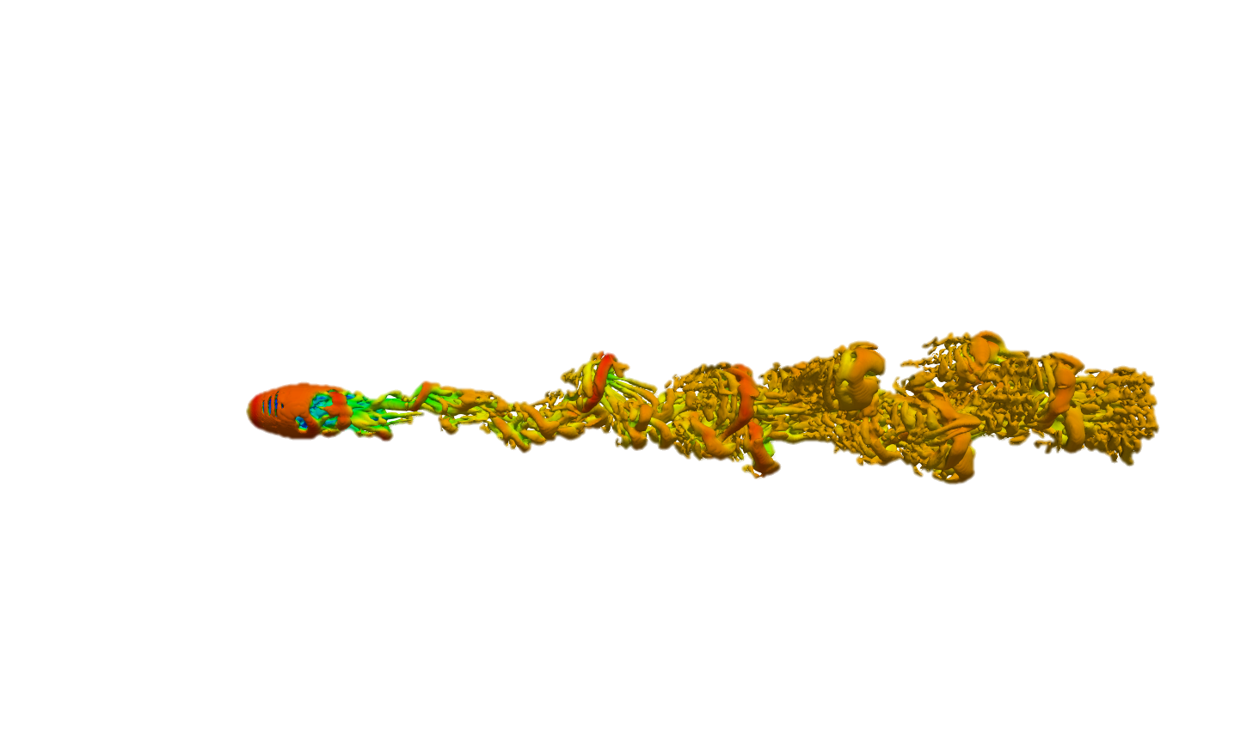
Q-Criteria
0.3 x 0.14x0.14: 8 Million
0.16x0.1x0.1 :128 Million

Slide 10
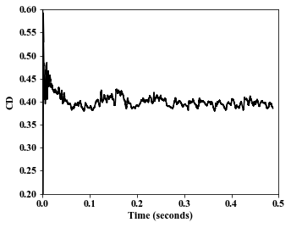
Instantaneous drag coefficients
8 Million
symmetry
0.3 x 0.14x0.14
128 Million
No-slip
0.16x0.1x0.1

Slide 11
8 Million
No-slip
0.3 x 0.14x0.14
8 Million
Constant velocity
0.3 x 0.14x0.14

Slide 12
Pressure Coefficient

Slide 13
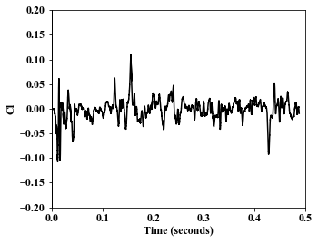
Instantaneous lift coefficients
8 Million
symmetry
0.3 x 0.14x0.14
128 Million
No-slip
0.16x0.1x0.1

Slide 14
8 Million
No-slip
0.3 x 0.14x0.14
8 Million
Constant velocity
0.3 x 0.14x0.14

Slide 15
Mean and Turbulent Velocity
8 Million
0.3 x 0.14x0.14

Slide 16
Mean and Turbulent Velocity
128 Million
0.16x0.1x0.1

Slide 17
Streamwise direction
8 Million
0.3 x 0.14x0.14
128 Million
0.16x0.1x0.1

Slide 18
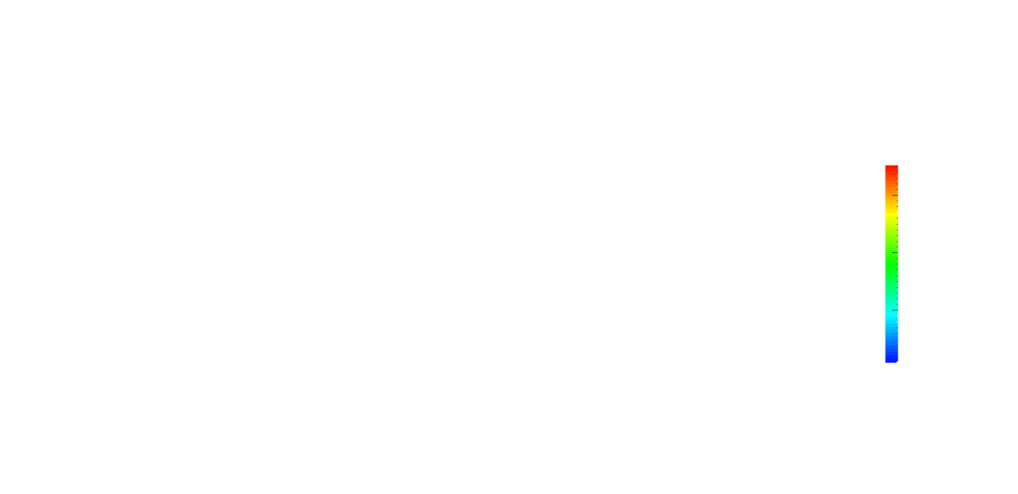
Re = 1 x 10⁵
14.1
12
8
4
0

Slide 19
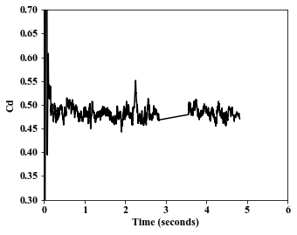
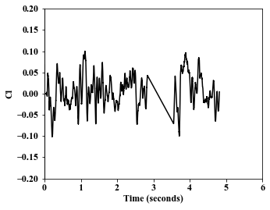
Drag and Lift Coefficients

Slide 20
Pressure Coefficient

Slide 21
Mean and Turbulent Statistics

Slide 22
Streamwise direction

Slide 23
Possible Conclusion
The time step should be smaller
Discretization schemes need to be of higher order
Statistical analysis need to be carried out for greater number of time steps
Radial distances should be farther away from the sphere diameter
Boundary conditions used on the domain walls should be such that they do not effect the flow field
Is there something called ‘Over Resolved’??

Slide 24
Conclusion
In case of free shear flows, it is not completely justifiable to say that the solution obtained is accurate just by looking at a single time averaged parameter. This could be misleading as parameters such as drag or lift coefficients may be in agreement with experimental data in a time averaged sense and yet the radial/ axial distances and the grid sizes used may lead to unwanted disturbances spatially. Thus validation studies must also include a sensitivity study of the velocity and pressure along the radial and axial distances and also along the azimuthal direction of the bluff body under consideration.

Slide 25
Conclusion
Using a wall boundary condition on the domain boundaries leads to disturbances in the velocity flow field. This occurs specifically when the domain the radial direction is less than 14d.
Frequencies are yet to be analyzed.
Appropriate CFL limit to be determined

